Slide 1
Unsupervised Learning : Clustering
The commonest form of unsupervised learning
Unsupervised learning = learning from raw data, as opposed to supervised data where a classification of examples is given
A common and important task that finds many applications in IR and other places

Slide 2
Classification & Clustering
Classification (supervised): we know the class information / Class labels/ we know the desired response
Clustering(Unsupervised): A loose definition of clustering could be “the process of organizing objects into groups whose members are similar in some way”.

Slide 3
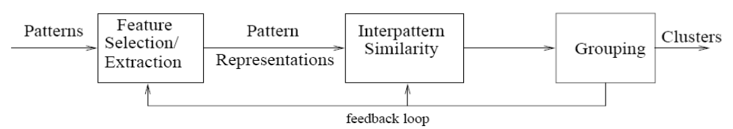
Overview of clustering
“Data clustering: review”
Feature Selection
  identifying the most effective subset of the original features to use in clustering
Feature Extraction
  transformations of the input features to produce new salient features.
Interpattern Similarity
  measured by a distance function defined on pairs of patterns.
Grouping
  methods to group similar patterns in the same cluster
Notes:
Features wrt microarray data can be genes
We will not talk about feature selection/extraction

Slide 4
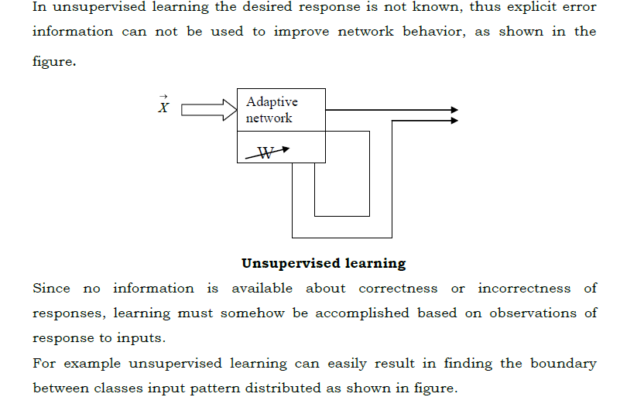
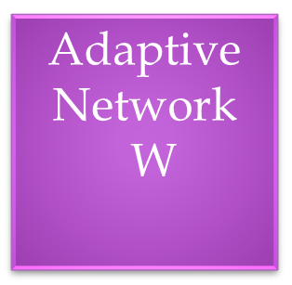
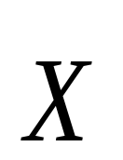






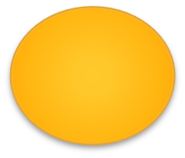

Slide 5
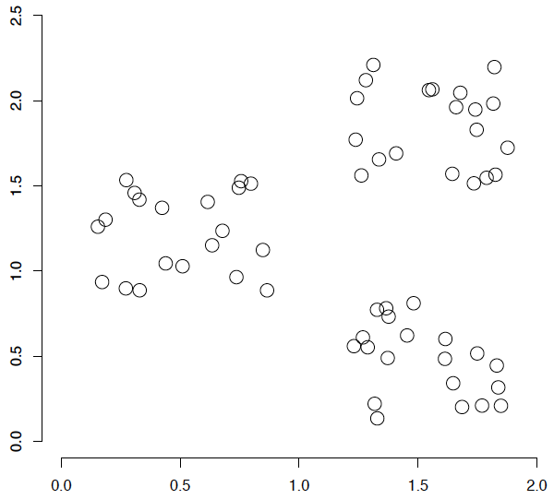
A data set with clear cluster structure
Ch. 16
How would you design an algorithm for finding the three clusters in this case?

Slide 6
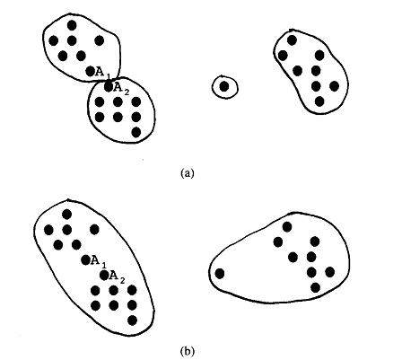
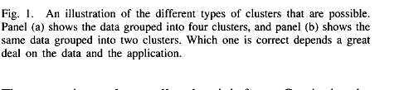
Clustering

Slide 7
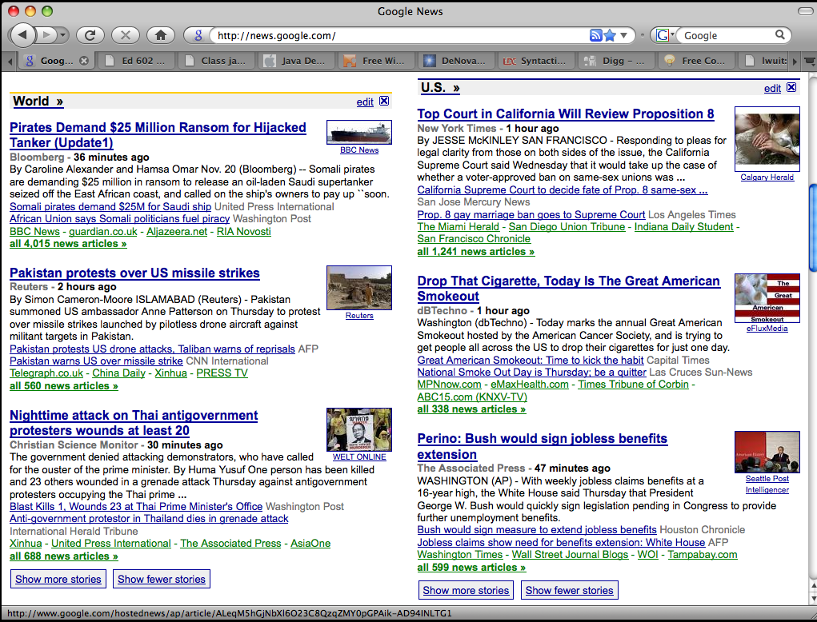
Google News: automatic clustering gives an effective news presentation metaphor

Slide 8
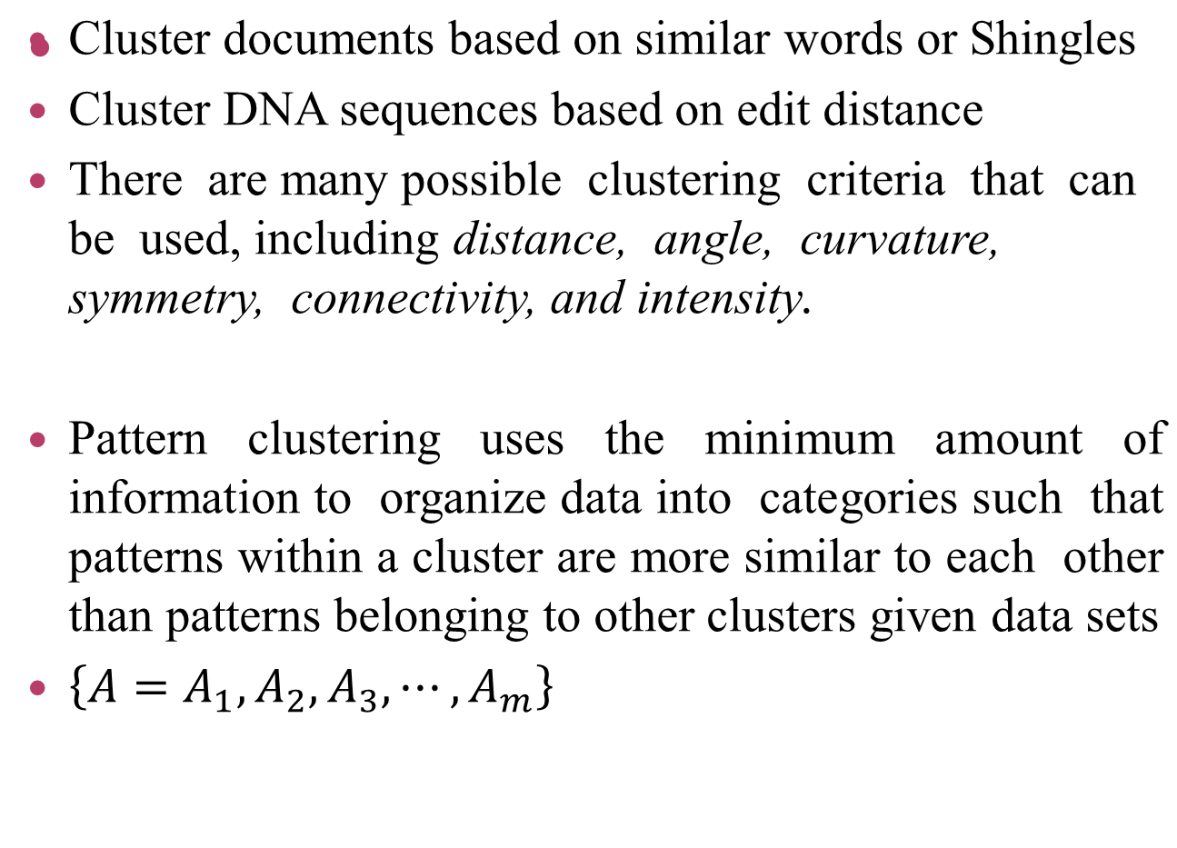
Clustering

Slide 9
Clustering
Traditional Clustering: There are many clustering algorithms that have been developed to date, including ISODATA, FORGY, WISH, and CLUSTER.
Clustering techniques to two popular methods:
    Hierarchical Clustering: A hierarchical clustering technique imposes a hierarchical structure on the data which consists of a sequence of clusters. The result is a tree with the data patterns at the leaves and successively higher branches representing larger clusters.
    Partitional Clustering: A partitional clustering technique organizes patterns into a small number of clusters by labeling each pattern in some way. Unlike hierarchical clustering, which offers several partitions of the data, partitional clustering finds a single cluster partition.

Slide 10
Clustering Algorithms
Flat algorithms
  Usually start with a random (partial) partitioning
  Refine it iteratively
    K means clustering
    (Model based clustering)
Hierarchical algorithms
  Bottom-up, agglomerative
  (Top-down, divisive)

Slide 11
Hard vs. soft clustering
Hard clustering: Each document belongs to exactly one cluster
  More common and easier to do
Soft clustering: A document can belong to more than one cluster.
  Makes more sense for applications like creating browsable hierarchies
  You may want to put a pair of sneakers in two clusters:
  (i) sports apparel and
  (ii) shoes You can only do that with a soft clustering approach.

Slide 12
Partitioning Algorithms
Partitioning method: Construct a partition of n documents into a set of K clusters
Given: a set of documents and the number K
Find: a partition of K clusters that optimizes the chosen partitioning criterion
  Globally optimal
    Intractable for many objective functions
    Ergo, exhaustively enumerate all partitions
  Effective heuristic methods:
  K-means and K-medoids algorithms

Slide 13
Hierarchical Clustering
Ch. 17
Build a tree-based hierarchical taxonomy (dendrogram) from a set of documents.
One approach: recursive application of a partitional clustering algorithm.
animal
vertebrate
invertebrate
fish reptile amphib. mammal worm insect crustacean

Slide 14
Dendrogram: Hierarchical Clustering
  Clustering obtained by cutting the dendrogram at a desired level: each connected component forms a cluster.

Slide 15
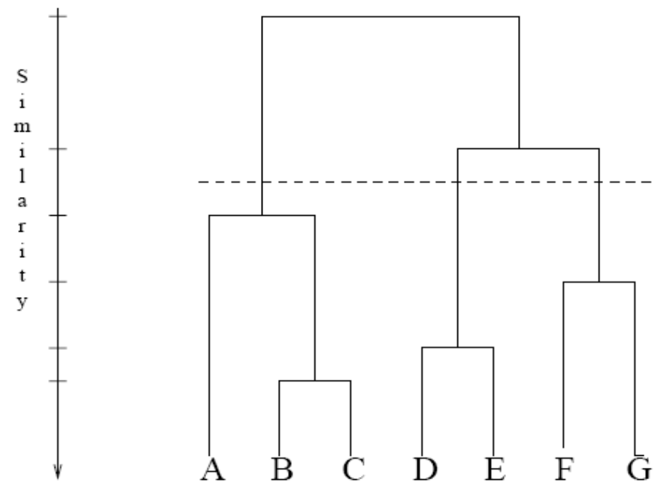
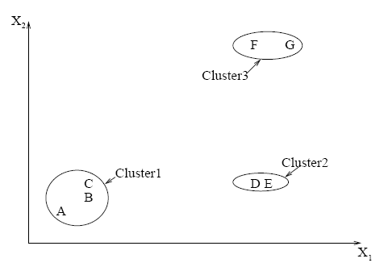
Hierarchical clustering: forming clusters
Forming clusters from dendograms

Slide 16
Purity example
Sec. 16.3
• •
• •
• •
• •
• •
• •
• •
• •
•
Cluster I
Cluster II
Cluster III
Cluster I: Purity = 1/6 (max(5, 1, 0)) = 5/6
Cluster II: Purity = 1/6 (max(1, 4, 1)) = 4/6
Cluster III: Purity = 1/5 (max(2, 0, 3)) = 3/5

Slide 17
Clustering Methods / Algorithms
Pattern Representation, Feature Selection and Extraction
Similarity Measures
Clustering Techniques
Hierarchical Clustering Algorithms
Partitional Algorithms
Mixture-Resolving and Mode-Seeking Algorithms
Nearest Neighbor Clustering
Fuzzy Clustering
Representation of Clusters
Artificial Neural Networks for Clustering
Evolutionary Approaches for Clustering
Search-Based Approaches
A Comparison of Techniques
Incorporating Domain Constraints in Clustering
Clustering Large Data Sets
Applications
Image Segmentation Using Clustering
Object and Character Recognition
Information Retrieval
Data Mining

Slide 18
Fuzzy c-means
An extension of k-means
Hierarchical, k-means generates partitions
  each data point can only be assigned in one cluster
Fuzzy c-means allows data points to be assigned into more than one cluster
  each data point has a degree of membership (or probability) of belonging to each cluster
Notes:
Compare degrees of memberships in k-means and fuzzy c-means

Slide 19
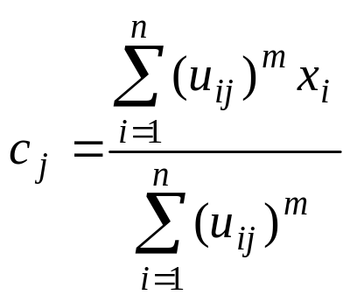
Fuzzy c-means algorithm
Let x_{i} be a vector of values for data point g_{i}.
Initialize membership U⁽⁰⁾ = [ u_{ij} ] for data point g_{i} of cluster cl_{j} by random
At the k-th step, compute the fuzzy centroid C^{(k)} = [ c_{j} ] for j = 1, .., nc, where nc is the number of clusters, using
  where m is the fuzzy parameter and n is the number of data points.

Slide 20
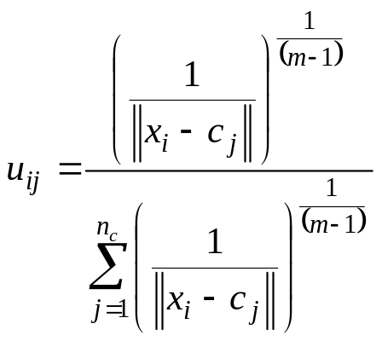
Fuzzy c-means algorithm
Update the fuzzy membership U^{(k)} = [ u_{ij} ], using
If ||U^{(k)} – U^{(k-1)}|| < ε, then STOP, else return to step 2.
Determine membership cutoff
  For each data point g_{i}, assign g_{i} to cluster cl_{j} if u_{ij} of U^{(k)} > α

Slide 21
Fuzzy c-means
Pros:
  Allows a data point to be in multiple clusters
  A more natural representation of the behavior of genes
    genes usually are involved in multiple functions
Cons:
  Need to define c, the number of clusters
  Need to determine membership cutoff value
  Clusters are sensitive to initial assignment of centroids
    Fuzzy c-means is not a deterministic algorithm

Slide 22
Similarity measures
How to determine similarity between data points
  using various distance metrics
Let x = (x₁,…,x_{n}) and y = (y₁,…y_{n}) be n-dimensional vectors of data points of objects g₁ and g₂
  g₁, g₂ can be two different genes in microarray data
  n can be the number of samples
Notes:
Material from “Data Analysis tools for DNA microarrays” by Sorin Draghici

Slide 23
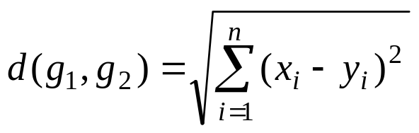
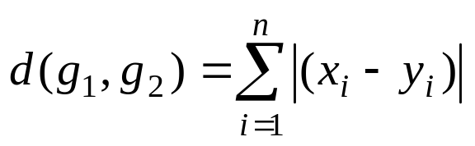
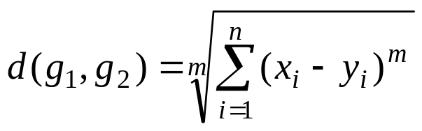
Distance measure
Euclidean distance
Manhattan distance
Minkowski distance

Slide 24
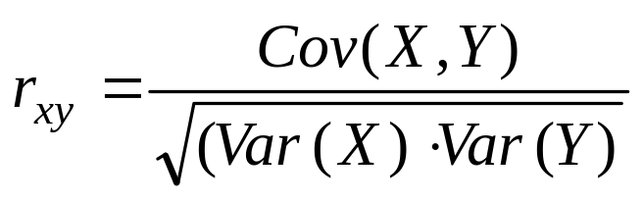
Correlation distance
Correlation distance
  Cov(X,Y) stands for covariance of X and Y
    degree to which two different variables are related
  Var(X) stands for variance of X
    measurement of a sample differ from their mean

Slide 25
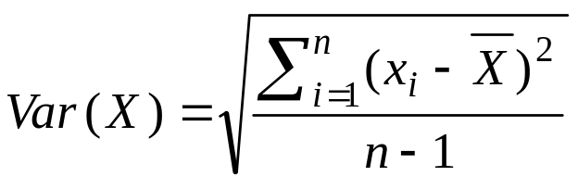
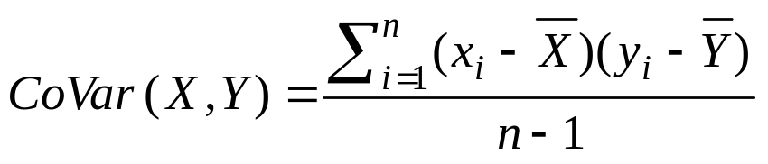
Correlation distance
Variance
Covariance
  Positive covariance
    two variables vary in the same way
  Negative covariance
    one variable might increase when the other decreases
  Covariance is only suitable for heterogeneous pairs

Slide 26
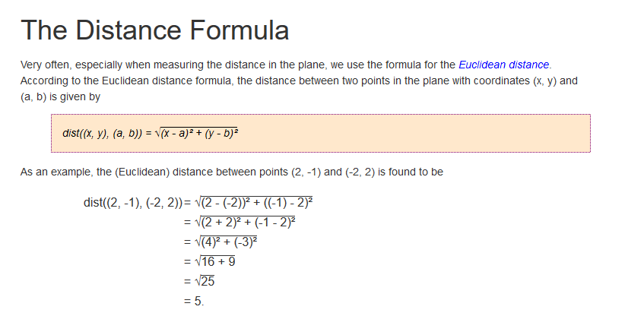
The Distance Formula

Slide 27
k-means clustering algorithm
k-means is one of the simplest unsupervised learning algorithms that solve the well known clustering problem
  The procedure follows a simple and easy way to classify a given data set through a certain number of clusters (assume k clusters) fixed apriori.
  Randomly place K points into the space represented by the objects that are being clustered. These points represent initial group centroids.
  Assign each object to the group that has the closest centroid.
  When all objects have been assigned, recalculate the positions of the K centroids.
  Repeat Steps 2 and 3 until the stopping criteria is met.

Slide 28
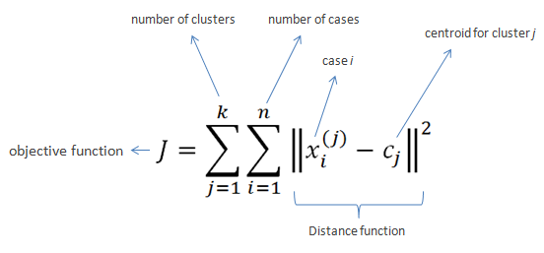
k-means clustering

Slide 29
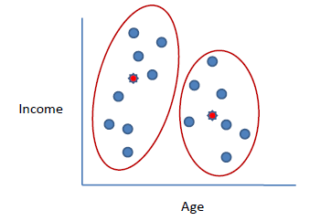
k-means clustering
Algorithm
Clusters the data into k groups where k is predefined.
Select k points at random as cluster centers.
Assign objects to their closest cluster center according to the Euclidean distance function.
Calculate the centroid or mean of all objects in each cluster.
Repeat steps 2, 3 and 4 until the same points are assigned to each cluster in consecutive rounds.

Slide 30
k-means clustering
K-Means is relatively an efficient method. However, we need to specify the number of clusters, in advance and the final results are sensitive to initialization and often terminates at a local optimum. Unfortunately there is no global theoretical method to find the optimal number of clusters. A practical approach is to compare the outcomes of multiple runs with different k and choose the best one based on a predefined criterion. In general, a large k probably decreases the error but increases the risk of overfitting.

Slide 31
k-means clustering
Example:
Suppose we want to group the visitors to a website using just their age (one-dimensional space) as follows:
n = 19
15,15,16,19,19,20,20,21,22,28,35,40,41,42,43,44,60,61,65

Slide 32
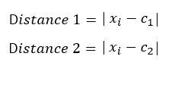
k-means clustering
Initial clusters (random centroid or average):
k = 2
c₁ = 16 c₂ = 22

Slide 33
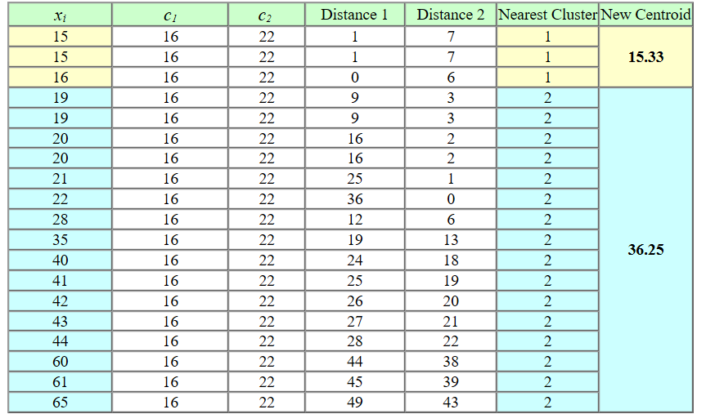
Iteration 1:
c₁ = 15.33
c₂ = 36.25

Slide 34
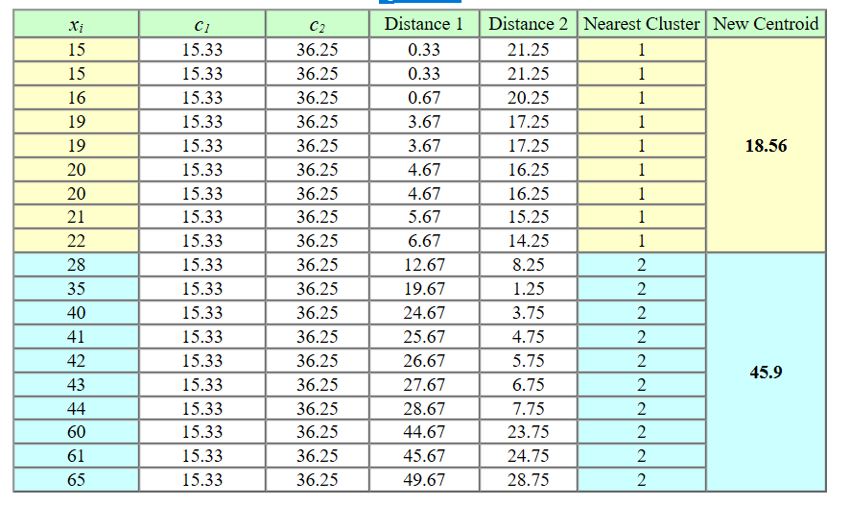
k-means clustering
Iteration 2:
c₁ = 18.56
c₂ = 45.90

Slide 35
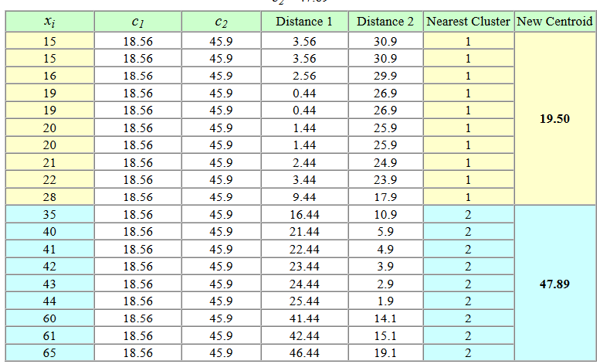
k-means clustering
Iteration 3:
c₁ = 19.50
c₂ = 47.89

Slide 36
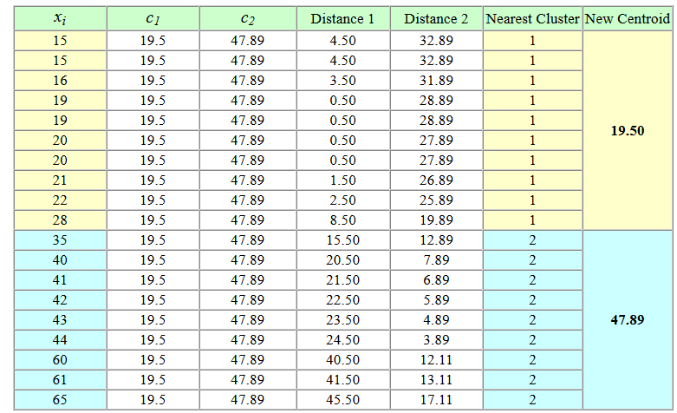
k-means clustering
Iteration 4
c₁ = 19.50
c₂ = 47.89

Slide 37
k-means clustering
No change between iterations 3 and 4 has been noted. By using clustering, 2 groups have been identified 15-28 and 35-65.
The initial choice of centroids can affect the output clusters, so the algorithm is often run multiple times with different starting conditions in order to get a fair view of what the clusters should be.

Slide 38
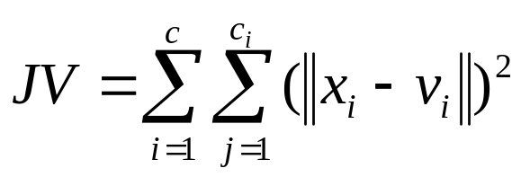
k-means clustering algorithm
A loop has been generated. As a result of this loop we may notice that the k centers change their location step by step until no more changes are done or in other words centers do not move any more.
algorithm aims at minimizing an objective function know as squared error function given by:
where,
‘||x_{i} - v_{j}||’ is the Euclidean distance between x_{i} and v_{j.}
‘c_{i}’ is the number of data points in i^{th} cluster.
‘c’ is the number of cluster centers.

Slide 39
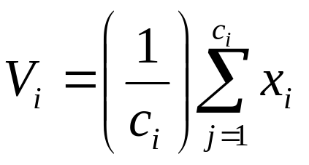
k-means clustering algorithm
Algorithmic steps for k-means clustering
Let X = {x₁,x₂,x₃,……..,x_{n}} be the set of data points and V = {v₁,v₂,…….,v_{c}} be the set of centers.
1) Randomly select ‘c’ cluster centers.
2) Calculate the distance between each data point and cluster centers.
3) Assign the data point to the cluster center whose distance from the cluster center is minimum of all the cluster centers..
4) Recalculate the new cluster center using:
5) Recalculate the distance between each data point and new obtained cluster centers.
6) If no data point was reassigned then stop, otherwise repeat from step 3).

Slide 40
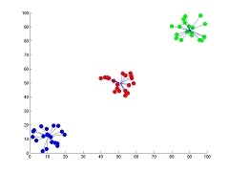
k-means clustering algorithm
Advantages
1) Fast, robust and easier to understand.
2) Relatively efficient: O(tknd), where n is # objects, k is # clusters, d is # dimension of each object, and t is # iterations. Normally, k, t, d << n.
3) Gives best result when data set are distinct or well separated from each other
Showing the result of k-means for 'N' = 60 and 'c' = 3

Slide 41
k-means clustering algorithm
Disadvantages
The learning algorithm requires apriori specification of the number of cluster centers.
The use of Exclusive Assignment - If there are two highly overlapping data then k-means will not be able to resolve that there are two clusters.
The learning algorithm is not invariant to non-linear transformations i.e. with different representation of data we get different results (data represented in form of cartesian co-ordinates and polar co-ordinates will give different results).
Euclidean distance measures can unequally weight underlying factors.5) The learning algorithm provides the local optima of the squared error function.
Randomly choosing of the cluster center cannot lead us to the fruitful result.
Applicable only when mean is defined i.e. fails for categorical data.
Unable to handle noisy data and outliers.
Algorithm fails for non-linear data set.

Slide 42
Syntax for K means clustering in matlab
Syntax
idx = kmeans(X,k)
idx = kmeans(X,k,Name,Value)
[idx,C] = kmeans(___)
[idx,C,sumd] = kmeans(___)
[idx,C,sumd,D] = kmeans(___)
By default, kmeans uses the squared Euclidean distance metric and the k-means++ algorithm for cluster center initialization.
Description
example
idx = kmeans(X,k) performs k-means clustering to partition the observations of the n-by-p data matrix X into k clusters, and returns an n-by-1 vector (idx) containing cluster indices of each observation. Rows of X correspond to points and columns correspond to variables.

Slide 43
K means clustering in matlab
Cluster data using k-means clustering, then plot the cluster regions.
Load Fisher's iris data set. Use the petal lengths and widths as predictors.
load fisheriris
X = meas(:,3:4);
figure;
plot(X(:,1),X(:,2),'k*','MarkerSize',5);
title 'Fisher''s Iris Data';
xlabel 'Petal Lengths (cm)';
ylabel 'Petal Widths (cm)';

Slide 44
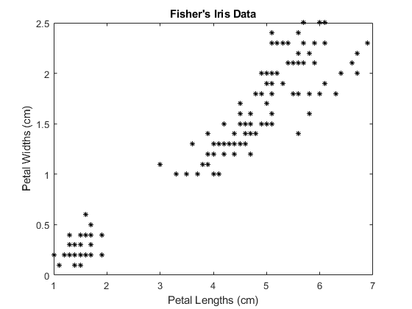
K means clustering in matlab

Slide 45
K means clustering in matlab
The larger cluster seems to be split into a lower variance region and a higher variance region. This might indicate that the larger cluster is two, overlapping clusters.
Cluster the data. Specify k = 3 clusters.
rng(1); % For reproducibility
[idx,C] = kmeans(X,3);
idx is a vector of predicted cluster indices corresponding to the observations in X. C is a 3-by-2 matrix containing the final centroid locations.

Slide 46
K means clustering in matlab
Use kmeans to compute the distance from each centroid to points on a grid. To do this, pass the centroids (C) and points on a grid to kmeans, and implement one iteration of the algorithm.
x1 = min(X(:,1)):0.01:max(X(:,1));
x2 = min(X(:,2)):0.01:max(X(:,2));
[x1G,x2G] = meshgrid(x1,x2);
XGrid = [x1G(:),x2G(:)]; % Defines a fine grid on the plot idx2Region = means(XGrid,3,'MaxIter',1,'Start',C);

Slide 47
Plot the cluster regions.
Plot the cluster regions.
figure; gscatter(XGrid(:,1),XGrid(:,2),idx2Region,... [0,0.75,0.75;0.75,0,0.75;0.75,0.75,0],'..');
hold on;
plot(X(:,1),X(:,2),'k*','MarkerSize',5);
title 'Fisher''s Iris Data'; xlabel 'Petal Lengths (cm)'; ylabel 'Petal Widths (cm)';
legend('Region 1','Region 2','Region 3','Data','Location','SouthEast');
hold off;

Slide 48
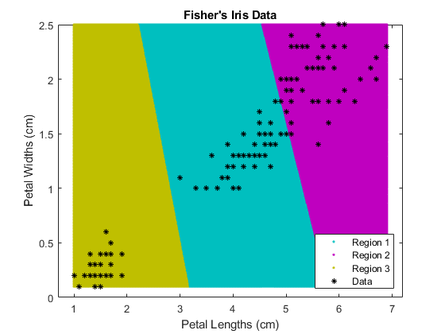
cluster regions

Slide 49
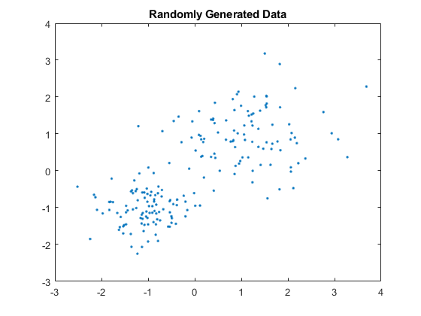
Example to generate
Randomly generate the sample data.
rng default; % For reproducibility
X = [randn(100,2)*0.75+ones(100,2); randn(100,2)*0.5-ones(100,2)];
figure; plot(X(:,1),X(:,2),'.');
title 'Randomly Generated Data';

Slide 50
Example to generate
Randomly generate the sample data.
There appears to be two clusters in the data.
Partition the data into two clusters, and choose the best arrangement out of five initializations. Display the final output.
opts = statset('Display','final');
[idx,C] = kmeans(X,2,'Distance','cityblock',... 'Replicates',5,'Options',opts);

Slide 51
Example to generate
Randomly generate the sample data
Replicate 1, 3 iterations, total sum of distances = 201.533. Replicate 2, 5 iterations, total sum of distances = 201.533. Replicate 3, 3 iterations, total sum of distances = 201.533. Replicate 4, 3 iterations, total sum of distances = 201.533. Replicate 5, 2 iterations, total sum of distances = 201.533. Best total sum of distances = 201.533
By default, the software initializes the replicates separately using k-means++.
Plot the clusters and the cluster centroids.

Slide 52

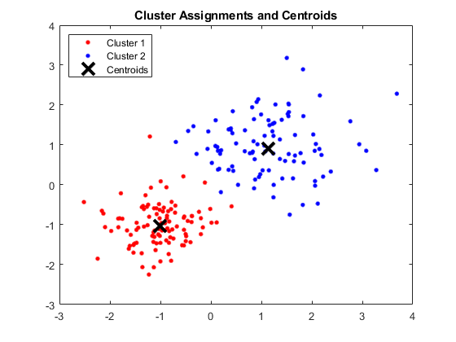
Example to generate
Randomly generate the sample data

Slide 53
Implementing K-Means in Octave/Matlab
We need to implement three methods to perform following tasks:
  Randomly initializing K centroids
  Assigning data points to K clusters
  Re-computing K centroids
  Step 1 will be performed in the start of the training process. Whereas, step 2 and 3 will be repeated in a loop until convergence.

Slide 54
Implementing K-Means in Octave/Matlab
function centroids = initCentroids(X, K)
centroids = zeros(K,size(X,2));
randidx = randperm(size(X,1));
centroids = X(randidx(1:K), :);
end
initCentroids method defined above will return K random indices from X as centroids. randperm method will randomly reorder the indices of the dataset (X).

Slide 55
Implementing K-Means in Octave/Matlab
function indices = getClosestCentroids(X, centroids)
K = size(centroids, 1);
indices = zeros(size(X,1), 1);
m = size(X,1);
for i=1:m
k = 1;
min_dist = sum((X(i,:) - centroids(1,:)) .^ 2);
for j=2:K
dist = sum((X(i,:) - centroids(j,:)) .^ 2);
if(dist < min_dist)
min_dist = dist;
k = j;
end end
indices(i) = k;
end
end

Slide 56
Implementing K-Means in Octave/Matlab
function centroids = computeCentroids(X, idx, K)
[m n] = size(X);
centroids = zeros(K, n);
for i=1:K
xi = X(idx==i,:);
ck = size(xi,1);
centroids(i, :) = (1/ck) * sum(xi);
end
end

Slide 57
Implementing K-Means in Octave/Matlab
X = %initialize dataset here
K = 3;
max_iterations = 10;
centroids = initCentroids(X, K);
for i=1:max_iterations
indices = getClosestCentroids(X, centroids);
centroids = computeCentroids(X, indices, K);
end

